Slide 1
Car Accident Severity
Coursera Capstone Project
M. Bilan – October 18, 2020

Slide 2
Problem
Six million car accidents occur each year in the United States.
Of these accidents, three million people are injured often permanently.
More than ninety people die every day from car accidents.
The injuries, deaths and property damage have untold personal and economic ramifications such as lost wages and productivity, increased insurance premiums and medical costs.
Source: http://www.driverknowledge.com

Slide 3
Project Objectives
To gain insight and understanding of the causes of accidents
To predict accident severity based on the attributes in the dataset. There are two different accident severity codes:
1 – Property Damage
2 - Injury

Slide 4
Data Acquisition
Data is from the Seattle DOF Traffic Management Division, Traffic Records
Stored in the Data-Collisions.csv file
Observations of traffic accidents from 2004 to present day and is updated weekly
Dataset has approximately 194,674 observations with 38 attributes

Slide 5
Data Cleaning & Preparation
Nonessential attributes were dropped from the dataset
Categorical data was converted to numerical or binary data
Fields containing NaN were also cleaned up
The following attributes were selected for analysis: WEATHER, ROADCOND, LIGHTCOND, SPEEDING, INATTENTIONIND, UNDERINFL

Slide 6
Unbalanced Dataset
136,485 or 70% of observations had a Severity Code of 1
58,188 or 30% of observations had a Severity Code of 2
This results in an unbalanced dataset
The dataset was resampled (under sampled) by reducing the number of observations with a Severity Code of 1

Slide 7
Insights About External Variables
72.8% of accidents occur when the weather is Dry (Clear, Partly Cloudy, Overcast)
65% of a car accidents occur when road conditions are Good(Dry)
61.4% of accidents occur when it is Light(Daylight) outdoors

Slide 8
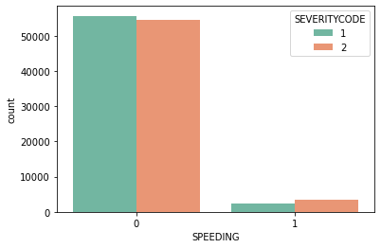
Insights About Driver Behavior Speeding
5.13% of car accidents involved speeding. Of these accidents, 49% resulted in property damage (Severity Code 1) while 59% resulted in injury (Severity Code 2)

Slide 9
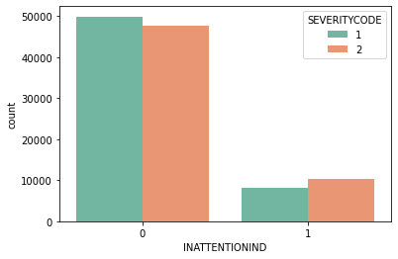
Insights About Driver Behavior Inattention
16% of car accidents involve drivers who were inattentive. Of these accidents, 44.3% resulted in property damage (Severity Code 1) while 55.7% resulted in injury (Severity Code 2)

Slide 10

Insights About Driver Behavior Under the Influence
5.15% of drivers involved in car accidents have a positive under the influence indicator. Of these accidents, 40.5% resulted in property damage (Severity Code 1) while 59.5% resulted in injury (Severity Code 2)

Slide 11
Target/Feature Set
Target(Y) Feature Set(X):
SEVERITYCODE | WEATHER | ROADCOND | LIGHTCOND | SPEEDING | INATTENTIONIND | UNDERINFL
2 | 2 | 2 | 2 | 1 | 0 | 0
1 | 0 | 0 | 0 | 0 | 1 | 0

Slide 12
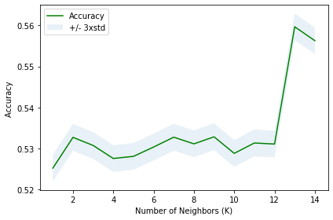
Modules/Results
Target(Y) Feature Set(X):
K Nearest Neighbor (KNN) - 80% training set, 20% testing set with the best K being 13 and a best accuracy of .5597
Decision Tree – 70% training set, 30% test set with an accuracy rate of .5617

Slide 13
Summary
Most car accidents occurred with good external driving conditions
Driver behavior such as speeding, inattention or driving under the influence resulted in a higher percentage of injury versus property damage
Driver inattention caused accidents were significantly higher than speeding or driving under the influence
The Decision Tree Classifier performed better than K Nearest Neighbors with .5617.

Slide 14
Recommendation
Public Safety officials should alert the public to the dangers of inattentive driving

